Slide 1

Module 9
Strings, Text IO, and Audio

Slide 2
Learning Objectives
Use String methods to process a CSV string
Build a Unity game that outputs text
Build a Unity game that plays sound effects

Slide 3
Strings

Slide 4
Content
The String Class
The StringBuilder Class
Exercise 32: Yer Birthday
Exercise 33: CSVs for Me
Getting Input
Putting It All Together
Common Mistakes

Slide 5

9.1 The String Class
A string is simply a sequence (or string) of characters.
Example:
or
C# lets us use the more compact syntax for assigning a value to a value type for string, even though string is actually a reference type.
We’ll typically use String when we’re talking about the class and string when we’re talking about an object of the class, but they’re essentially the same thing.
you can get the complete set of methods from the MSDN documentation for the String class.

Slide 6

9.1 The String Class
Example: find out how long a string is by accessing the Length property
find characters or strings within a string by using the IndexOf method
find the location of a string in another string using the IndexOf method
extract the substring that represents how many thousands of dollars the car costs from carPrice

Slide 7
9.2 The StringBuilder Class
The String class is very useful in C#, and it is used a lot. But it's immutable.
Once we create a string object, we can't change that object. We can certainly make changes and put them in a different string object (that's exactly what the Substring method does), but sometimes what we really want to do is change this object instead of creating a new one.
Use the StringBuilder class instead of a string.
We have to explicitly use the class constructor when we create a StringBuilder object:
add the hyphen to lastName

Slide 8
9.2 The StringBuilder Class
What if we know we're done changing lastName and we want to put it into a string variable called finalLastName rather than a StringBuilder? We use the ToString method to convert the StringBuilder object to a string:
The StringBuilder class also provides other useful methods, including methods that let us remove substrings, insert substrings at particular locations, and even replace substrings with other substrings.

Slide 9
Exercise 32: Yer Birthday
View LMS

Slide 10
Exercise 33: CSVs for Me
View LMS

Slide 11
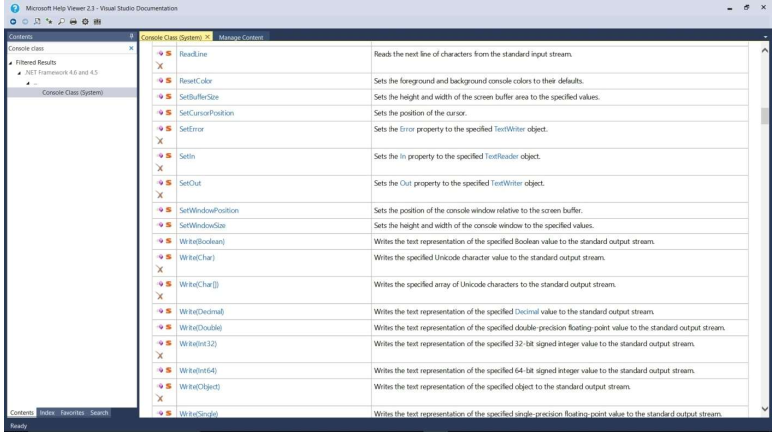
9.3 Getting Input
Console Class Documentation

Slide 12
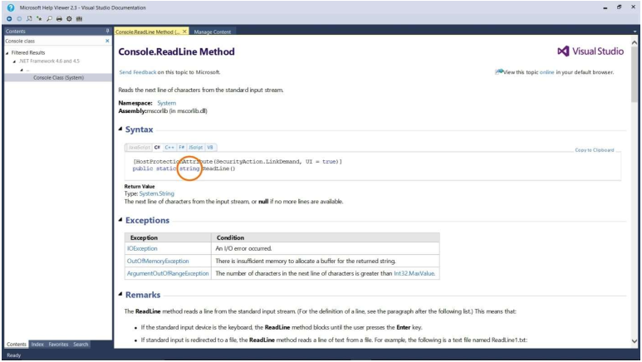
9.3 Getting Input
ReadLine Method Documentation

Slide 13
9.3 Getting Input
code to read in a user name
“converts the string representation of a number to its 32-bit signed integer equivalent.” – the Parse method

Slide 14

9.4 Putting It All Together
The problem description: Read in the names (first name, middle initial, and last name) of three different people from the user. Print the three names in the following format: lastName, firstName middleInitial. Also, identify the last names that are hyphenated.
Understand the Problem
After printing the 3 names in the above format (we HAVE to meet that requirement), let's print the three last names again with an indicator of whether or not they're hyphenated, like:

Slide 15
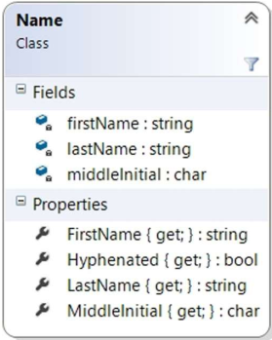
9.4 Putting It All Together
Design a Solution
Class Diagram for the Name Class

Slide 16
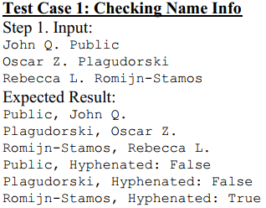
9.4 Putting It All Together
Design a Solution
Write Test Cases

Slide 17
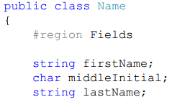
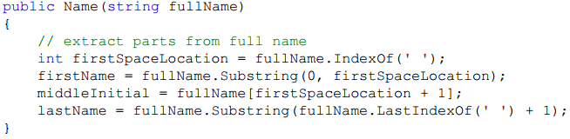
9.4 Putting It All Together
Design a Solution
Write the Code

Slide 18




9.4 Putting It All Together
Write the Code

Slide 19
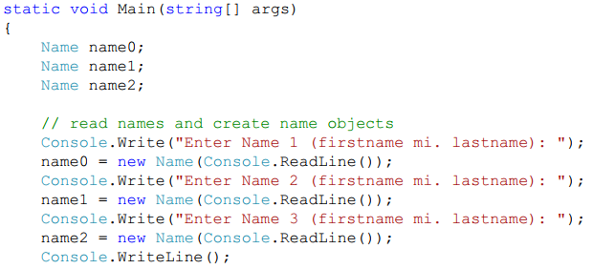
9.4 Putting It All Together
Write the Code

Slide 20
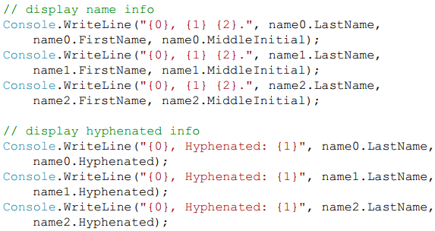

9.4 Putting It All Together
Write the Code

Slide 21
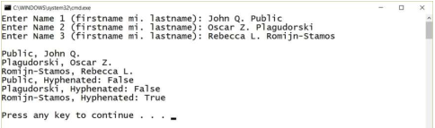
9.4 Putting It All Together
Test the Code
Test Case 1: Checking Name Info Results

Slide 22
9.4 Common Mistakes
Forgetting That Character Locations Are Zero-Based

Slide 23
Text IO

Slide 24
Content
A Big Idea
Text Output
Text Input
Putting It All Together: The Circle Problem in Unity
Exercise 31: The Counting Bouncer

Slide 25
9.5 A Big Idea
An important idea in Unity UI: the Canvas component.
As the Unity manual says, “The Canvas component represents the abstract space in which the UI is laid out and rendered.”
Think of a Canvas as a place we put our UI elements on and you have the basic concept.
Sometimes we'll have a single canvas in our scene and sometimes we'll have multiple canvases, but every UI element we include in the scene will be a child of a GameObject that has a Canvas component attached to it.

Slide 26
9.6 Text Output
One of the things that we’ve been sorely missing in our games so far is the ability to share textual information with the player.
Example: games regularly have a score, and though we could certainly keep track of a player’s score using a variable, we don’t currently have a way to tell the player what their score is!
Add a score display to the fish game we built in Module 5, where the player drives a fish around eating teddy bears.
First, we need to add a Text component to our scene. Right click in the Hierarchy window and select UI > Text.
Select ScoreText in the Hierarchy window and change the Pos X and Pos Y values in the Rect Transform component to move the text to be near the upper left corner of the screen (we used -300 and 160 for these values).
In the Text (Script) component, change the Font Style to Bold, the Font Size to 24, and the Color to white.

Slide 27
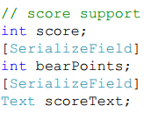
9.6 Text Output
In the Text (Script) component, change the Font Style to Bold, the Font Size to 24, and the Color to white.
If you run the game now, you'll see that you can use the keyboard to drive the fish around eating teddy bears, but the score display always says New Text.
add fields and processing to the Fish script to have it keep track of the current score and to update the score display when it destroys a teddy bear:
a score field to keep track of the current score, a bearPoints field that tells how many points each bear is worth, and a scoreText field that saves a reference to the ScoreText component for efficiency.

Slide 28
9.6 Text Output
In the Unity editor, select the Fish game object in the Hierarchy window. Set the Bear Points value in the Inspector to 10 and drag the Score Text component from the Hierarchy window onto the Score Text field in the Inspector. Click the Overrides dropdown near the top of the Inspector and click the Apply All button to apply the changes to the prefab.
Set the score text properly when the game starts; the appropriate place to do that is in the Fish Start method, but before we can do that we need to know how to interact with a Text object to change the text it displays.

Slide 29
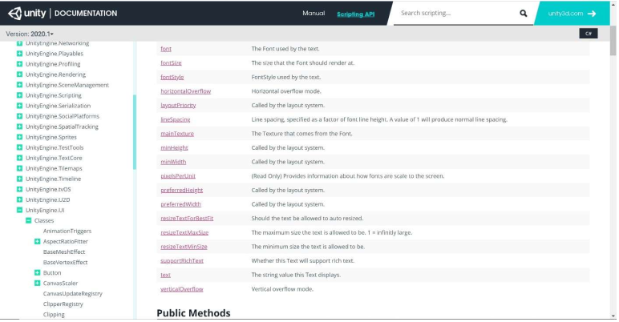
9.6 Text Output
Text class document

Slide 30

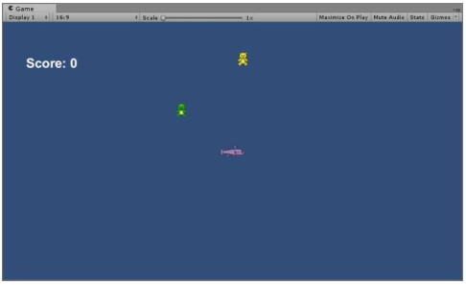
9.6 Text Output
Add the following code to the Fish Start method
Initial output score

Slide 31

9.6 Text Output
In the Fish OnCollisionEnter2D method when we detect a collision between the fish's head and a teddy bear:

Slide 32
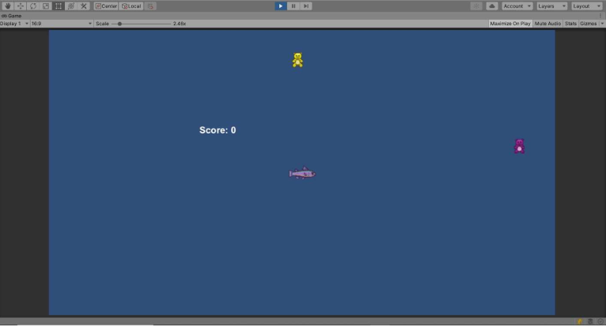
9.6 Text Output
Maximize on Play Score Output

Slide 33
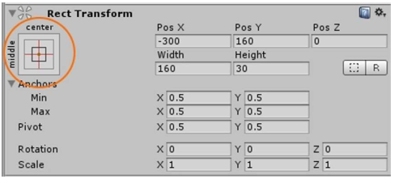
9.6 Text Output
The score is definitely not in the correct place any more.
Select the ScoreText game object in the Hierarchy window. In the Inspector, click the circled area in the Rect Transform component as shown in the below Figure.
Anchor Presets Button

Slide 34
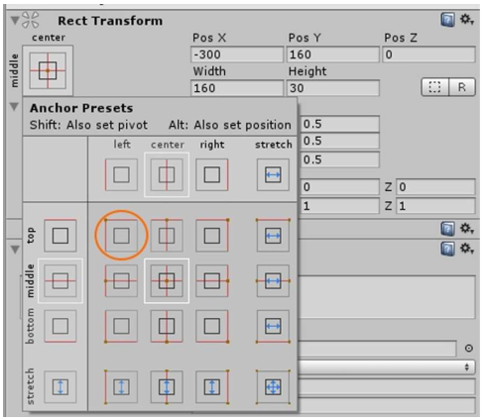
9.6 Text Output
Clicking this button gives us access to a set of presets for anchoring our Text component to a particular position on the Canvas. Select the circled preset as shown in the below Figure, which will anchor the Text component to the upper left corner of the Canvas.
Upper Left Anchor Preset

